Slide 1

Flood Measurement from a Photo
By
Shaffer, Hoke, Pander & Kuehl Partners

Slide 2




Partners
Clint Hoke
Jamie Shaffer
Jonna Pander
Josh Kuehl

Slide 3

Agenda
Problem Statement
Research
Solution
Issues

Slide 4

Problem: Create a machine model that can detect flood depth from a photo.

Slide 5
Research
Scholarly Articles
Resources
APIs
Libraries
*Full list of research available here

Slide 6







Solution
Latitude and Longitude
Elevation
Local Elevation Flood Prediction
Earth Engine
EXIF
Approximate Flood Depth
Image
Vision AI
True
Depth 4
~ 4 feet
Depth 3
~ 3 feet
AND
VGG16 cNN
Depth 2
~ 2 feet
True
Depth 1
~ 6 inches
Depth 0
No submersion
AND/OR
True
Depth 4
~ 4 feet
Depth 3
~ 3 feet
Depth 2
~ 2 feet
Depth 1
~ 1 foot
Depth 0
No submersion

Slide 7
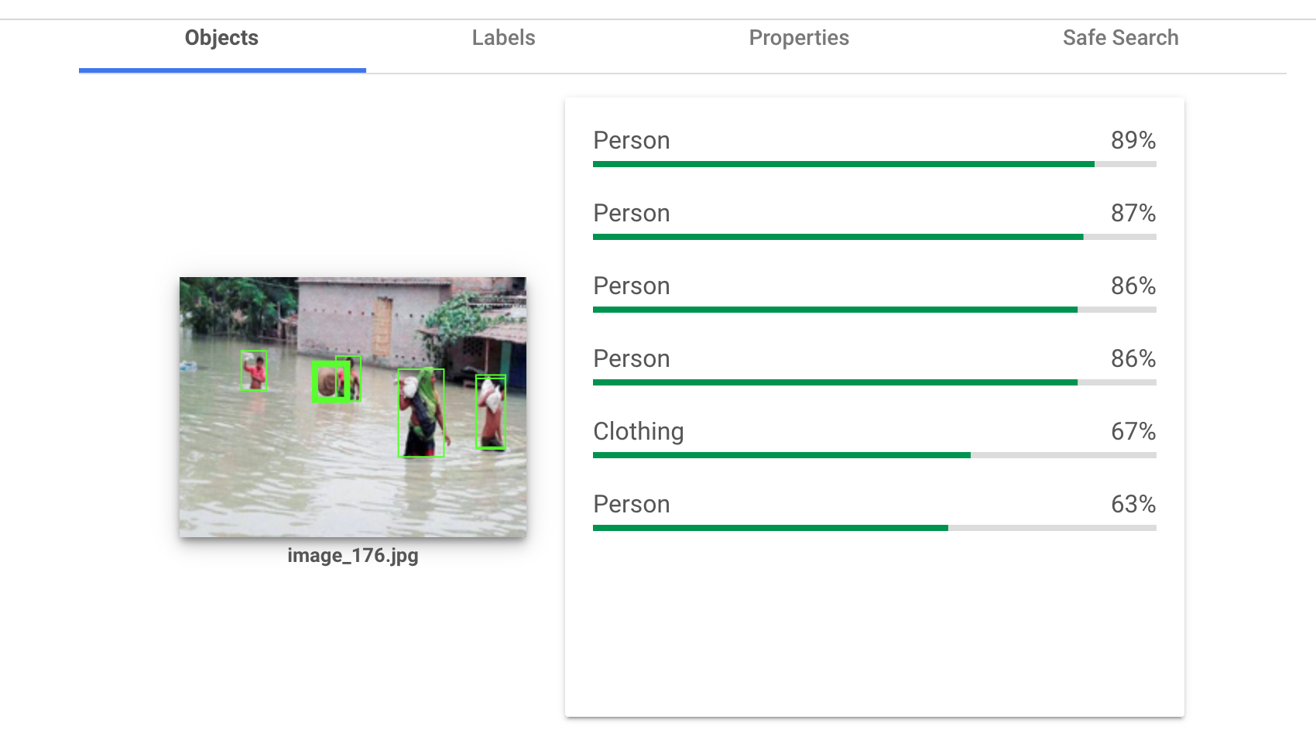
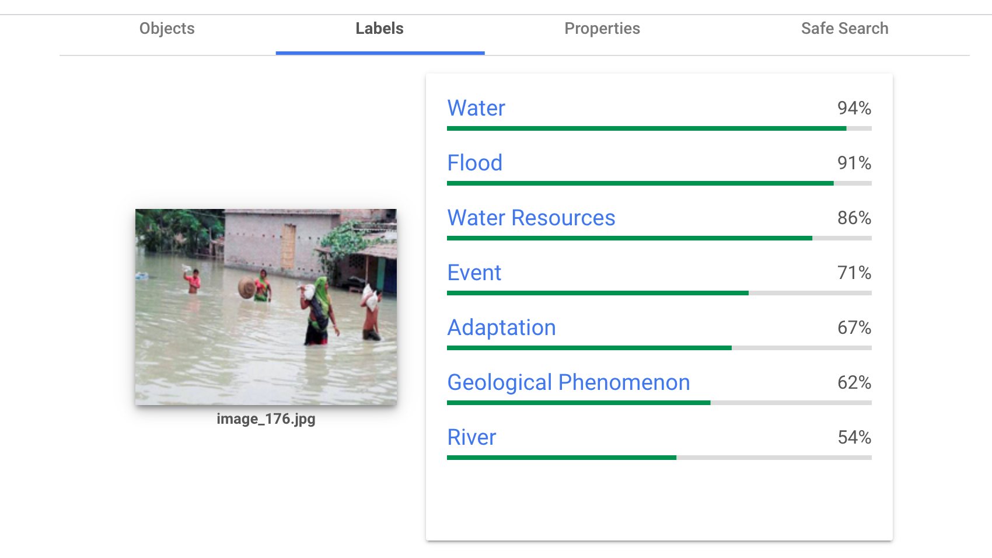
Google Vision AI
Detect objects automatically
Data labeling service
Image pre-processor
Built API to run batches of images
Paid Service

Slide 8
Image
Processing
Latitude and Longitude
Elevation
Local Elevation Flood Prediction
Earth Engine
EXIF
Approximate Flood Depth
Image
Vision AI
True
Depth 4
~ 4 feet
Depth 3
~ 3 feet
AND
VGG16 cNN
Depth 2
~ 2 feet
True
Depth 1
~ 6 inches
Depth 0
No submersion
AND/OR
True
Depth 4
~ 4 feet
Depth 3
~ 3 feet
Depth 2
~ 2 feet
Depth 1
~ 1 foot
Depth 0
No submersion

Slide 9
Person
Depth
Depth 4
~ 4 feet
Depth 3
~ 3 feet
Depth 2
~ 2 feet
Depth 1
~ 6 inches
Depth 0
No submersion

Slide 10
Truck Depth
Depth 4
~ 4 feet
Depth 3
~ 3 feet
Depth 2
~ 2 feet
Depth 1
~ 1 foot
Depth 0
No submersion

Slide 11
Results
Truck Model
People Model
Exact Accuracy: 32%
Tolerance(+/-1) Accuracy: 80%
Most accurate at depths 0 - 2
Exact Accuracy: 25%
Tolerance(+/-1) Accuracy: 60%
Most accurate at depths 0 and 4

Slide 12
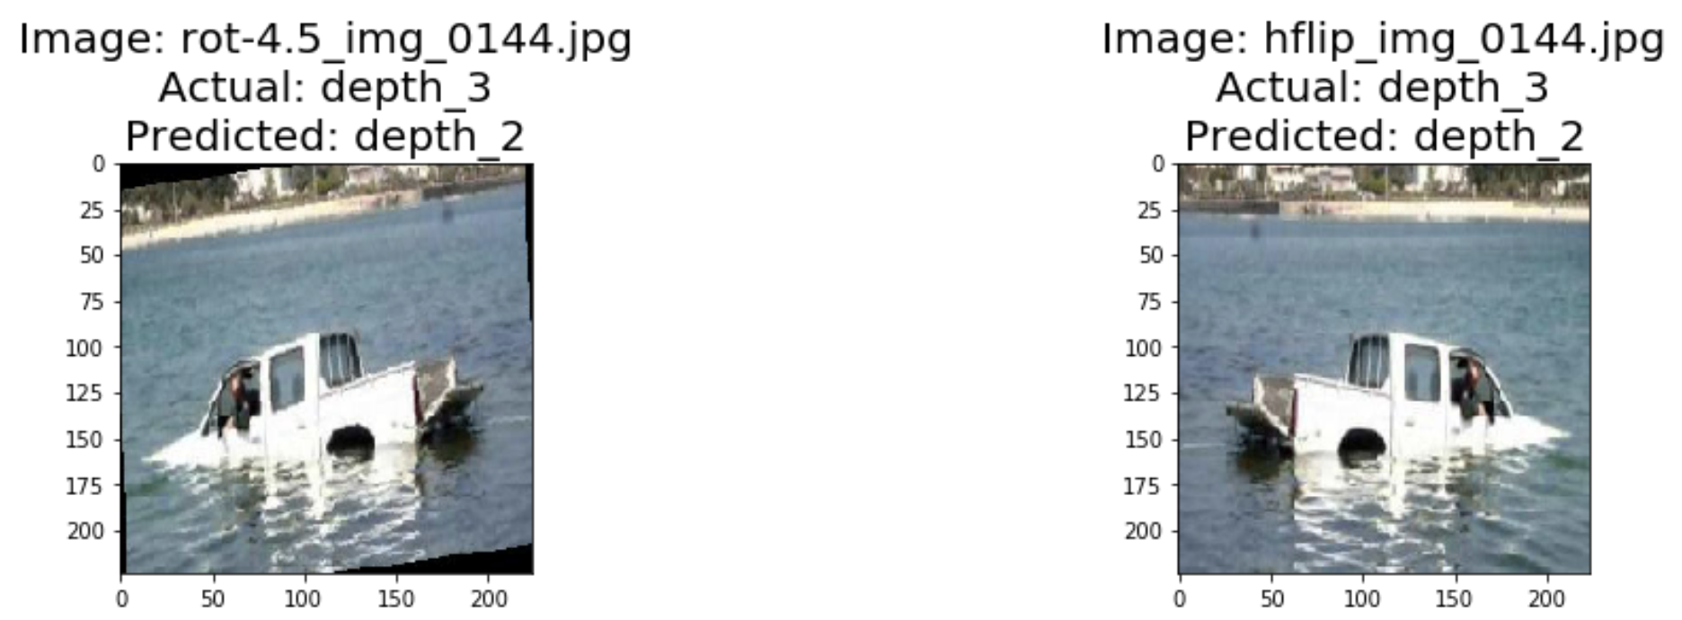
Image Augmentation and Challenges

Slide 13
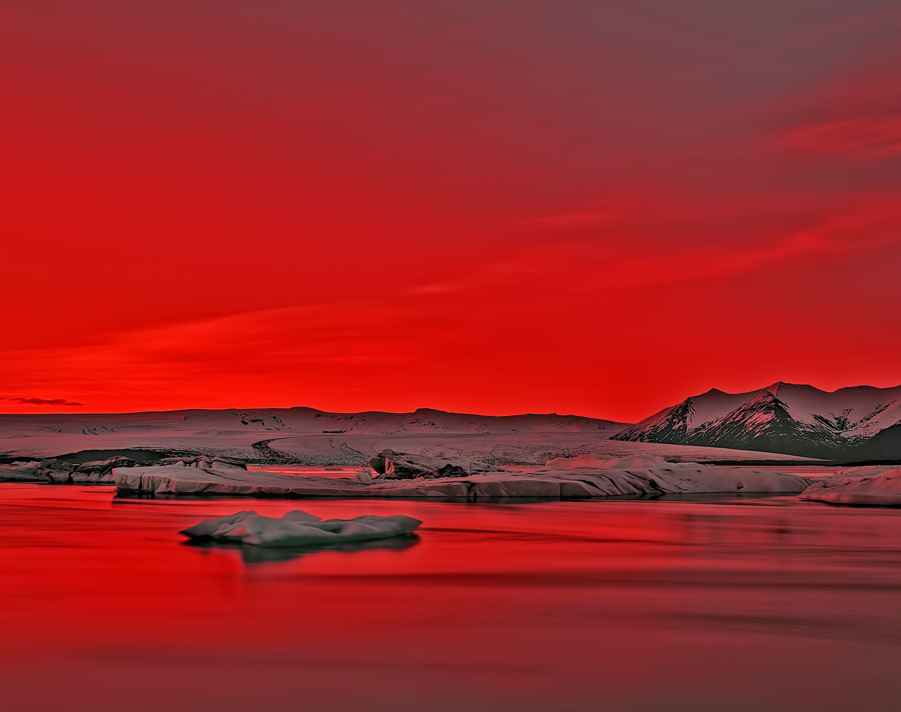
Issues
People can swim
Shortage of training data
Bow wake
Personal computer processing power
Complex images
Micro terrain
Time constraint
Definition of levels

Slide 14

Questions

